Slide 1
KHATRA ADIBASI MAHAVIDYALAYA P.O- Khatra, Dist.-Bankura, West Bengal, Pin-722140 name – proff Tithi Roy Semester - II Subject- Physical Education Course Tittle ANATOMY, PHYSIOLOGY AND PHYSIOLOGY OF EXERCISE AND SPORTS
Topic- Definition of muscle, its types, Structure and function of muscle and Types of Muscular contraction Session: 2022-23

Slide 2
THE MUSCULAR SYSTEM

Slide 3
Muscle Definition A muscle is a group of muscle tissues which contract together to produce a force. A muscle consists of fibers of muscle cells surrounded by protective tissue, bundled together many more fibers, all surrounded in a thick protective tissue. A muscle uses ATP to contract and shorten, producing a force on the objects it is connected to. There are several types of muscle, which act on various parts of the body.

Slide 4
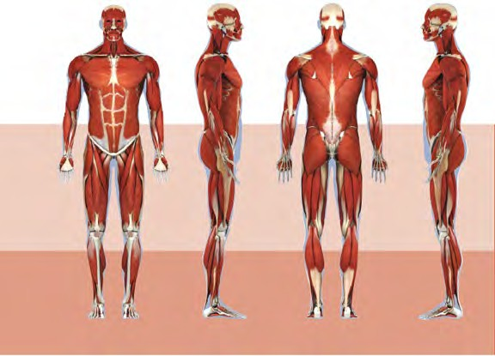

Slide 5
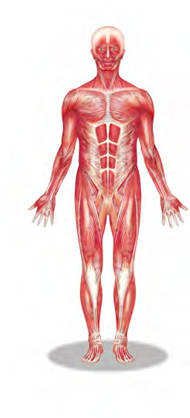
The muscular system creates body heat
and also moves the:
Bones of the Skeletal system
Food through Digestive system
Blood through the Circulatory system
Fluids through the Excretory system

Slide 6
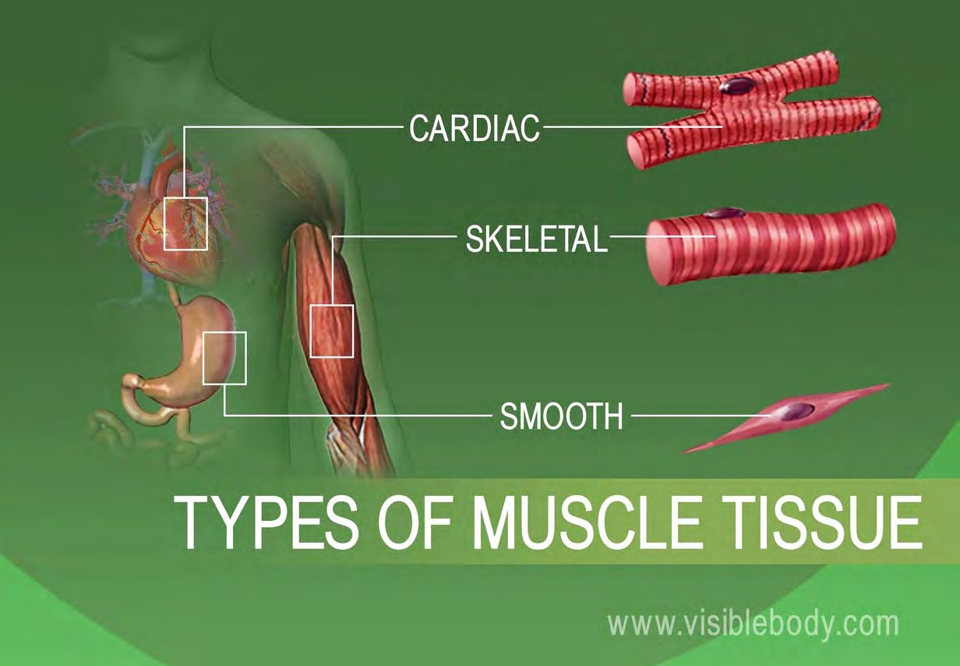
MUSCLE TISSUE
The body has 3 main types of muscle tissue
1) Skeletal, 2) Smooth, and 3) Cardiac

Slide 7
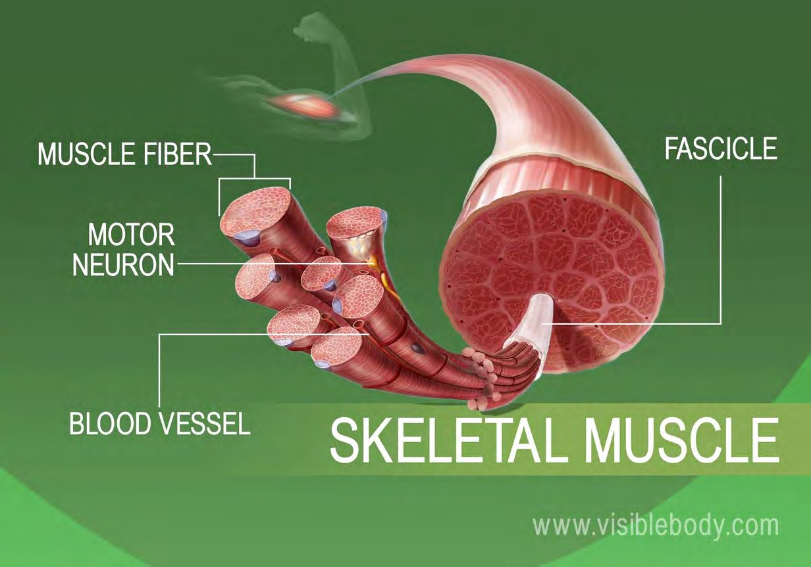
Skeletal muscles attach to and move bones by contracting and relaxing in response to voluntary messages from the nervous system.
Skeletal muscle tissue is composed of long cells called muscle fibers that have a striated appearance.
Muscle fibers are organized into bundles supplied by blood vessels and innervated by motor neurons.

Slide 8
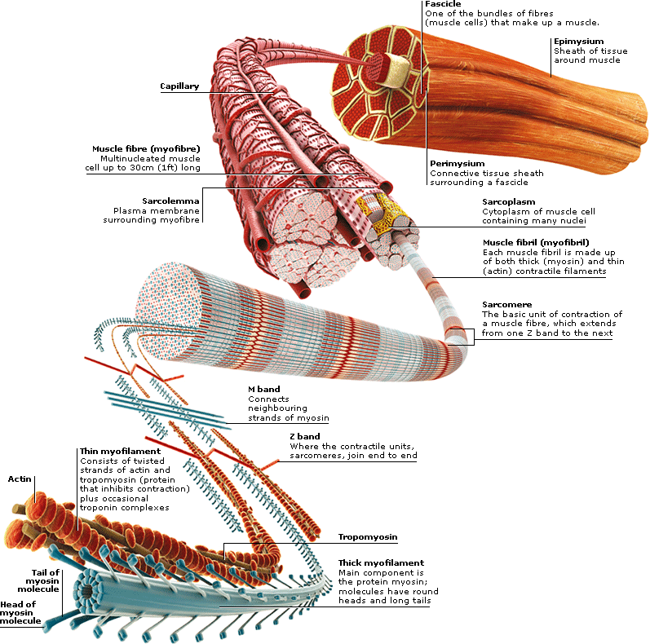
Muscle structure
Skeletal (striated or voluntary) muscle consists of densely packed groups of hugely elongated cells known as myofibers.
These are grouped into bundles (fascicles).
A typical myofiber is 2–3 centimeters ( 3/4–1 1/5 in) long and 0.05millimeters (1/500 inch) in diameter and is composed of narrower structures – myofibrils. These contain thick and thin myofilaments made up mainly of the proteins actin and myosin. Numerous capillaries keep the muscle supplied with the oxygen and glucose needed to fuel contraction.

Slide 9
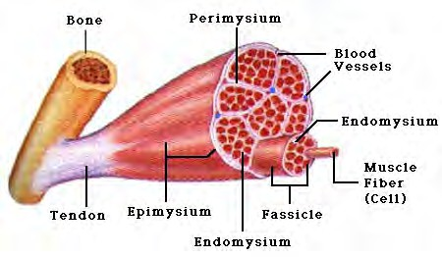
Skeletal Muscles
Skeletal muscles attach to bones by tendons (connective tissue) and enable movement.
Skeletal muscles are mostly voluntary
Feel the back of your ankle to feel your Achilles tendon
- the largest tendon in your body.

Slide 10
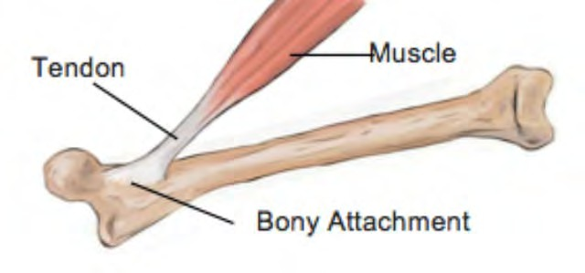
The typical male body contains approximately 640 muscles, which compose around two-fifths of its weight.
The same number in a female body make up a slightly smaller proportion.
A typical muscle spans a joint and tapers at each end into a fibrous tendon anchored to a bone. Some muscles divide to attach to different bones.

Slide 11
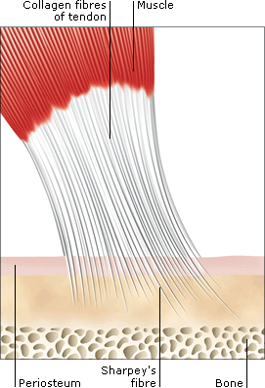
TENDONS
Tendons are tough, fibrous cords of connective tissue that link skeletal muscles to bones.
Within them, Sharpey’s fibers pass through the bone covering (periosteum) to embed in the bone.
Tendons in the hands and feet are enclosed in self- lubricating sheaths to protect them from rubbing against the bones.
From the hand bones, tendons extend upwards to muscles near the elbow.

Slide 12
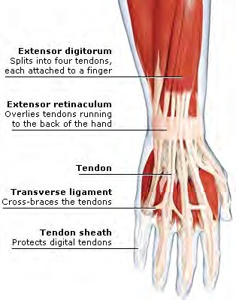
Tendons and Tendon Sheaths in the hand.

Slide 13
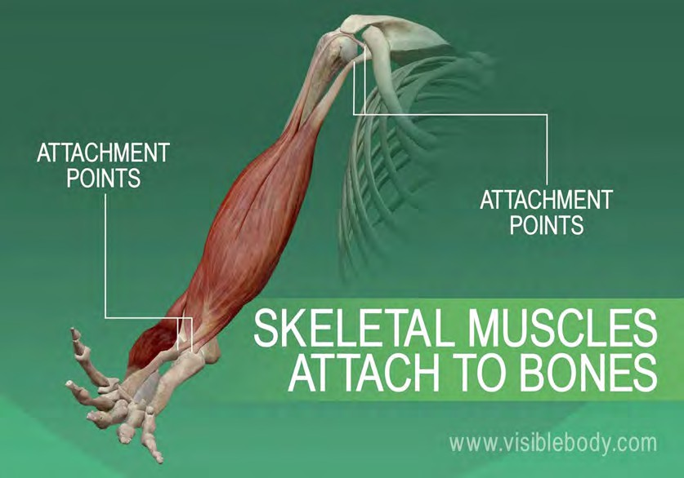
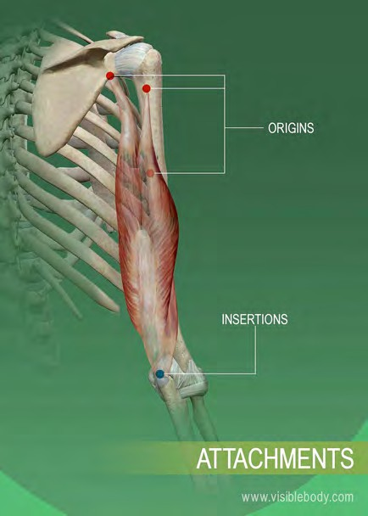
SKELETAL MUSCLES
Skeletal muscles are also known as voluntary muscles, since we control their actions at will, and as striated muscles, from their microscopic appearance.
In the muscular system, skeletal muscles are connected to the skeleton, either to bone or to connective tissues such as ligaments.
Muscles are always attached at two or more places.
When the muscle contracts, the attachment points are pulled closer together; when it relaxes, the attachment points move apart.

Slide 14
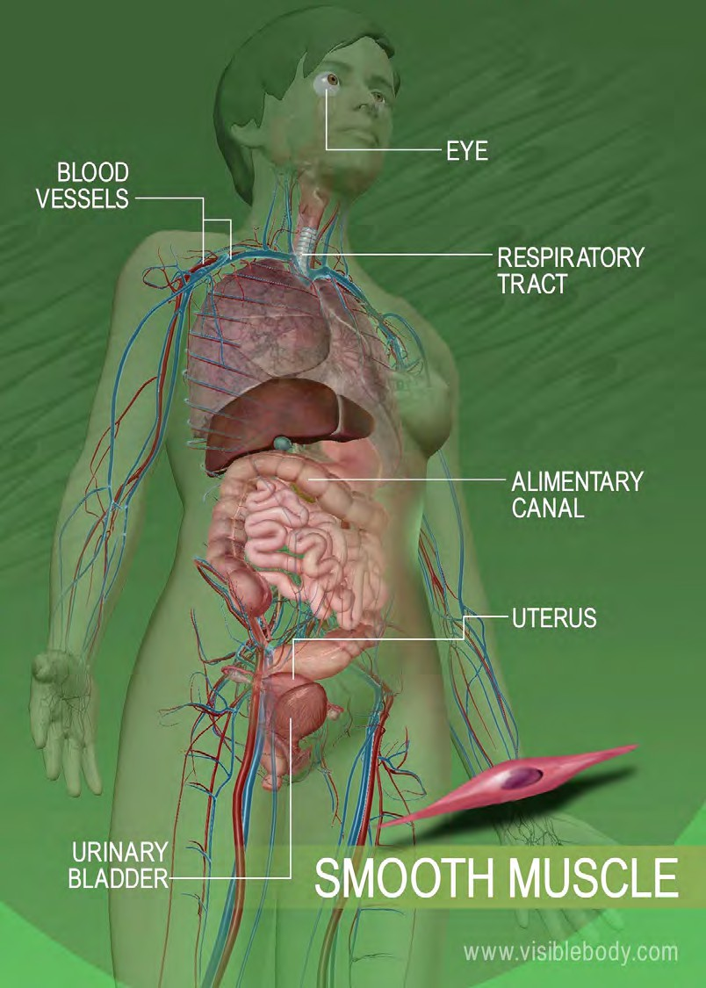
A second type is smooth muscle, in the walls of body parts such as the airways, stomach, Alimentary canal, and blood vessels.
This is called involuntary muscle, because it works automatically rather than under conscious control, or smooth muscle, from its magnified appearance

Slide 15
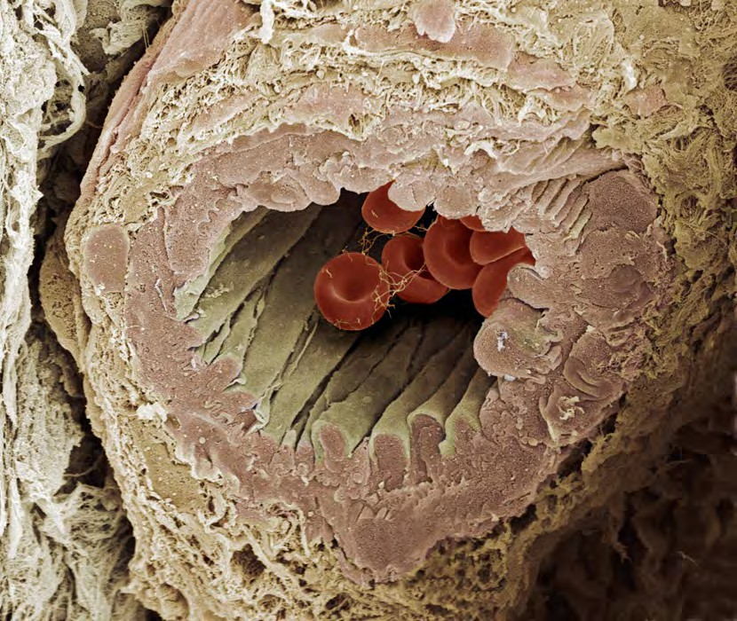
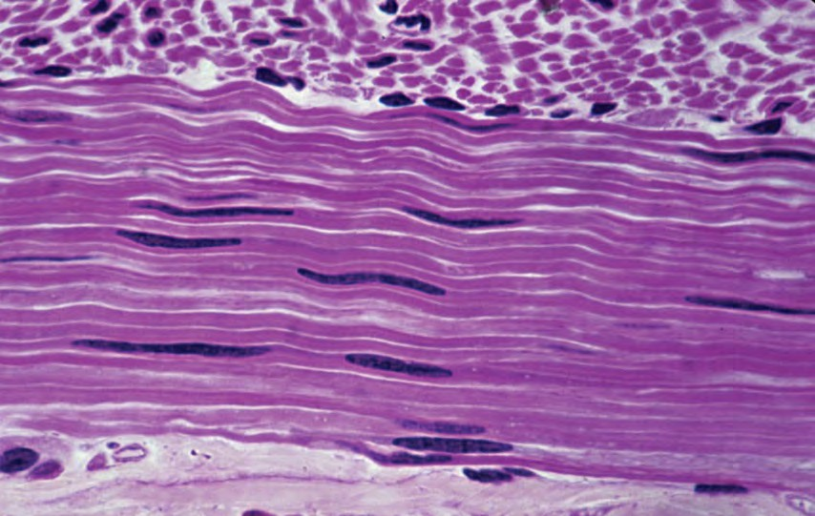
Smooth muscle lines organs and is involuntary.
moves food through digestive organs
empties liquid from the bladder
controls width of the blood vessels
Smooth muscle around this artery allows the artery to regulate blood flow by shrinking and expanding
SMOOTH MUSCLE

Slide 16
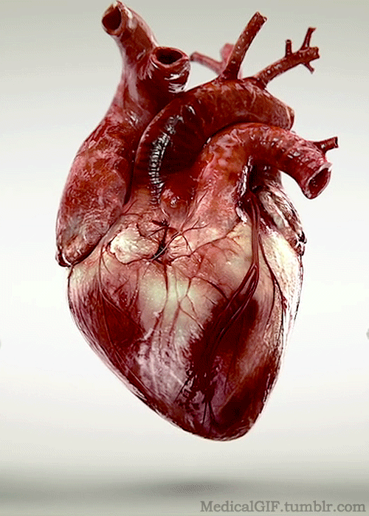
The third type is cardiac muscle, making up the walls of the heart.
It is part of both the Muscular System and the Circulatory System.
It is responsible for circulating blood throughout the body.
It has its own pacemaker for rhythmic beating.

Slide 17
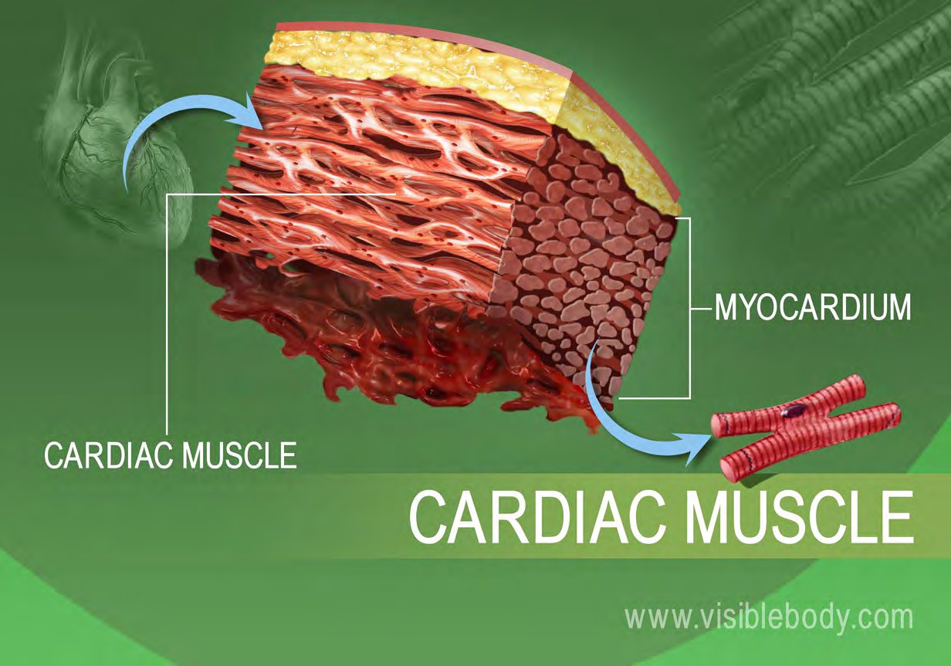
The heart wall is composed of three layers.
The middle layer, the myocardium, is responsible for the heart’s pumping action.
Cardiac muscle, found only in the myocardium, contracts in response to signals from the cardiac conduction system to make the heart beat.
Cardiac muscle is made from cells called cardiocytes.

Slide 18
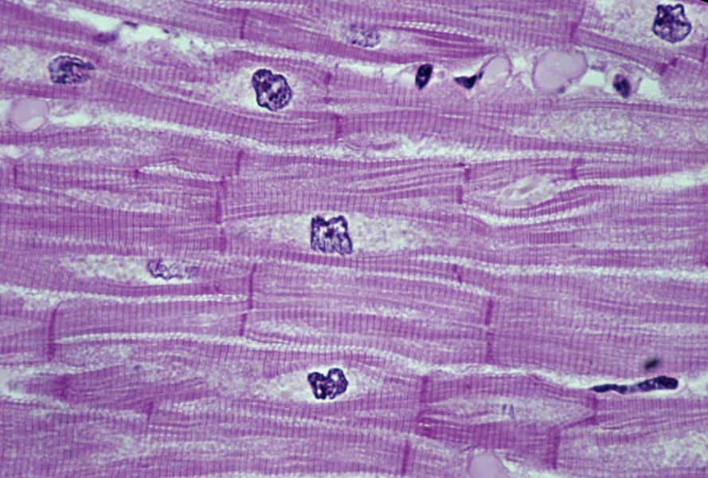
Cardiac muscle is found only in the heart.
pumps blood throughout body
contains more mitochondria than skeletal muscle cells
CARDIAC MUSCLE

Slide 19
THANK YOU

